Slide 1

Database Management System Lecture 3
Engr. Dr SAIMA WASEEM
School of Systems and Technology (SST)
Artificial Intelligence Faculty

Slide 2
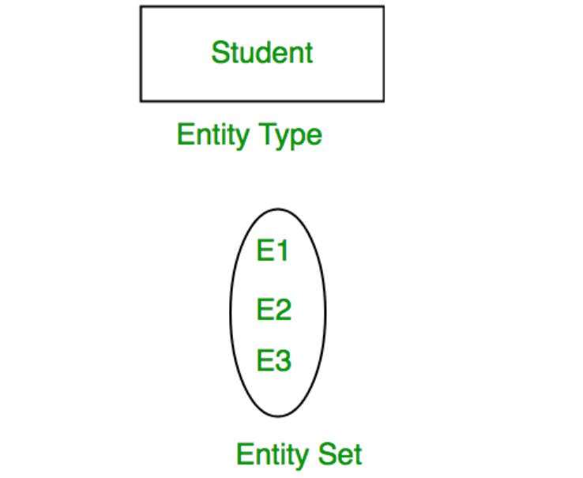

Slide 3
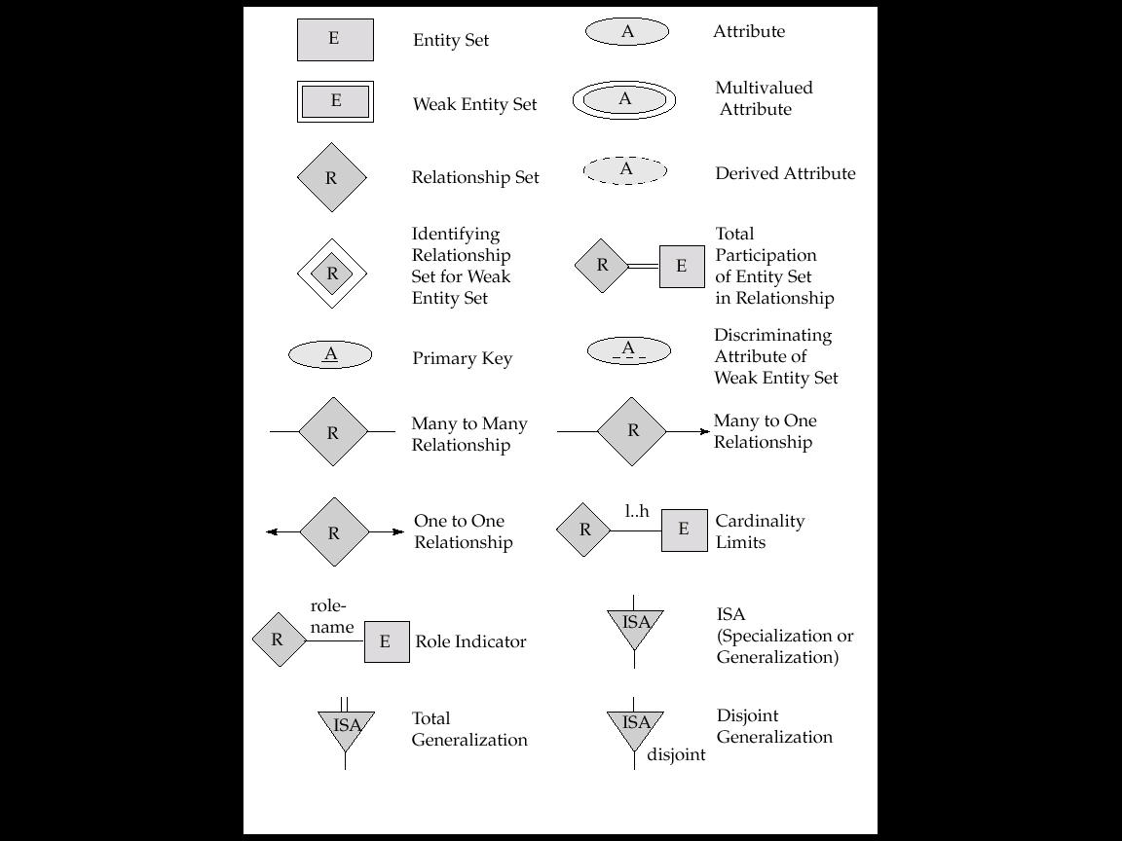
Summary of Symbols Used in E-R Notation

Slide 4
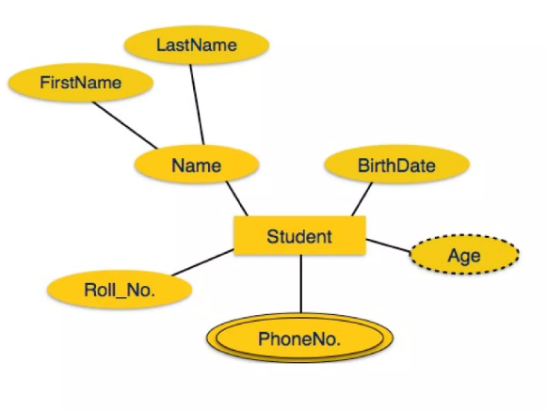

Slide 5
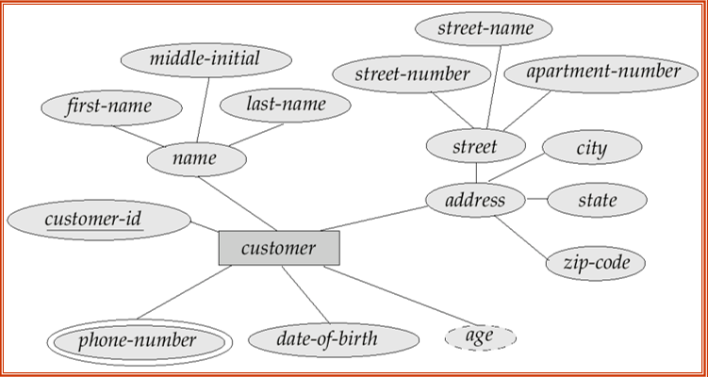

Slide 6
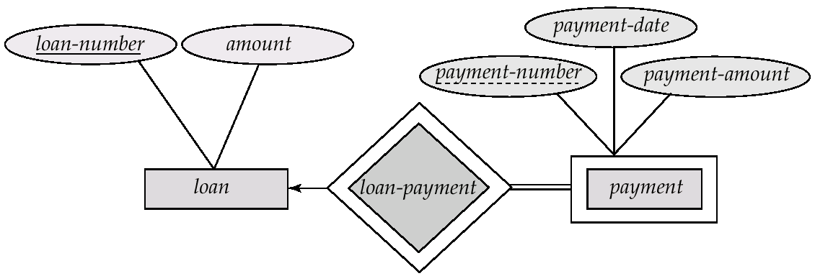
Weak Entity and Regular/Strong Entity
We depict a weak entity by double rectangles.
The identifying relationship is depicted using a double diamond.

Slide 7
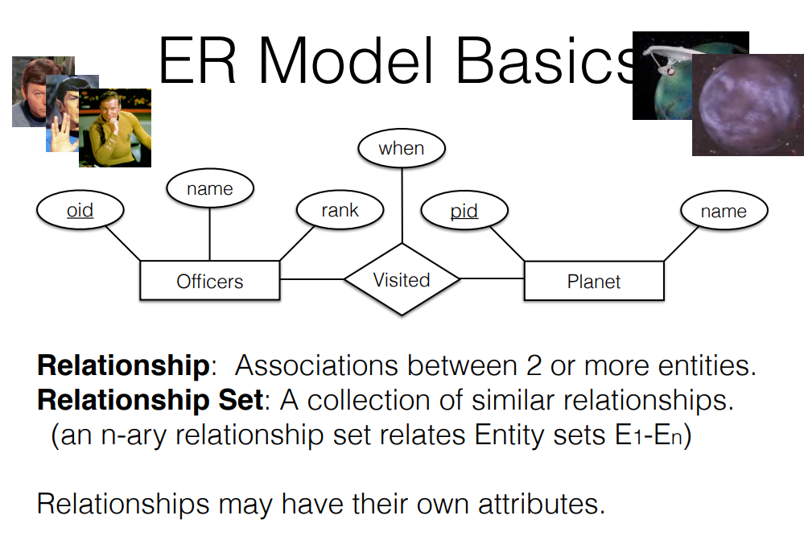

Slide 8
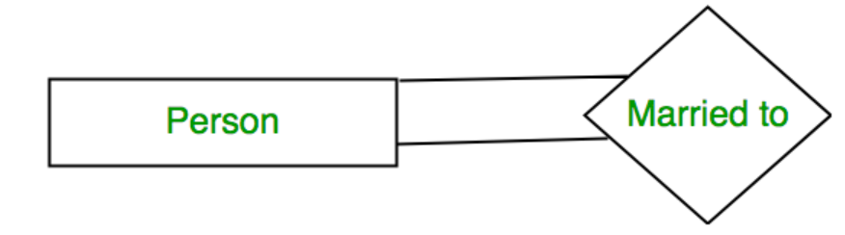
Degree of a Relationship Set
The number of different entity sets participating in a relationship set is called the degree of a relationship set.
1. Unary Relationship: When there is only ONE entity set participating in a relation, the relationship is called a unary relationship. For example, one person is married to only one person.

Slide 9
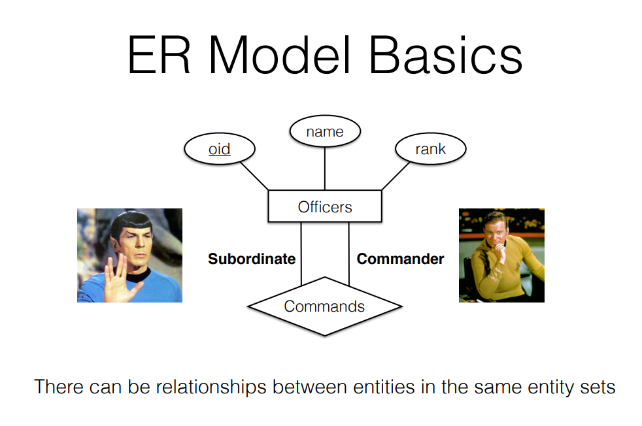

Slide 10
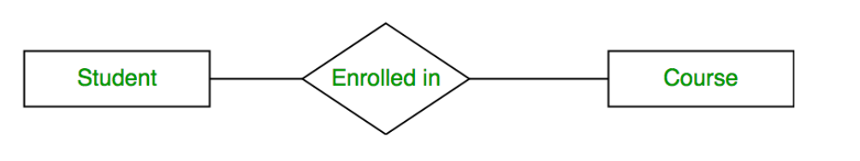
Degree of a Relationship Set
2. Binary Relationship: When there are TWO entities set participating in a relationship, the relationship is called a binary relationship. For example, a Student is enrolled in a Course.

Slide 11
Degree of a Relationship Set
3. Ternary Relationship: When there are three entity sets participating in a relationship, the relationship is called a ternary relationship.
4. N-ary Relationship: When there are n entities set participating in a relationship, the relationship is called an n-ary relationship.

Slide 12
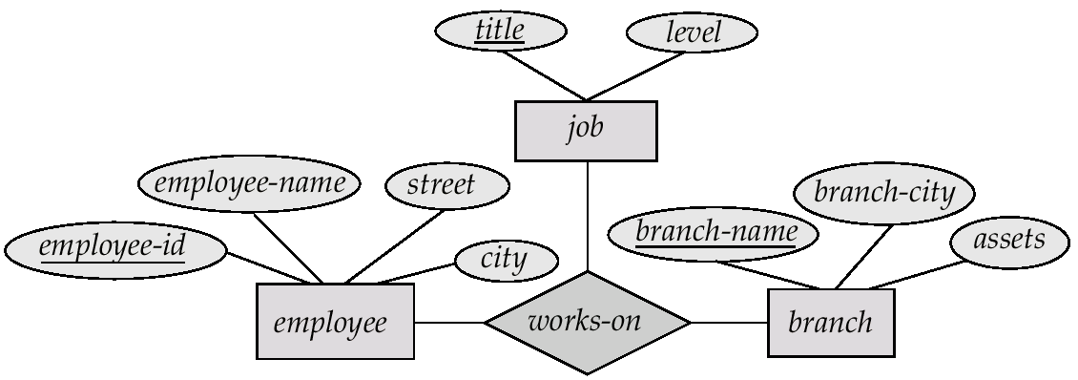
E-R Diagram with a Ternary Relationship

Slide 13
Cardinality in ER Model
The maximum number of times an entity of an entity set participates in a relationship set is known as cardinality.
Cardinality can be of different types:

Slide 14
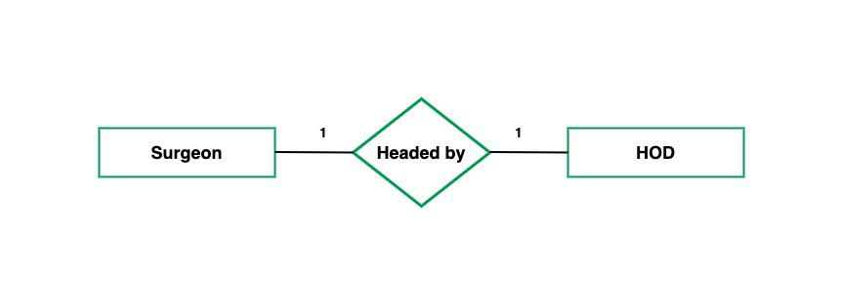
1. One-to-One
When each entity in each entity set can take part only once in the relationship, the cardinality is one-to-one. Let us assume that a male can marry one female and a female can marry one male. So the relationship will be one-to-one.

Slide 15
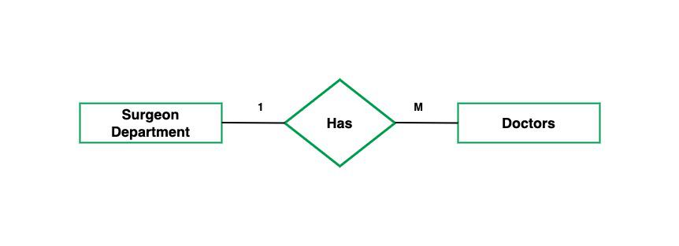
2. One-to-Many
In one-to-many mapping as well where each entity can be related to more than one entity. Let us assume that one surgeon department can accommodate many doctors. So the Cardinality will be 1 to M. It means one department has many Doctors.

Slide 16
3. Many-to-One
When entities in one entity set can take part only once in the relationship set and entities in other entity sets can take part more than once in the relationship set, cardinality is many to one.
Let us assume that a student can take only one course but one course can be taken by many students. So the cardinality will be n to 1. It means that for one course there can be n students but for one student, there will be only one course.

Slide 17
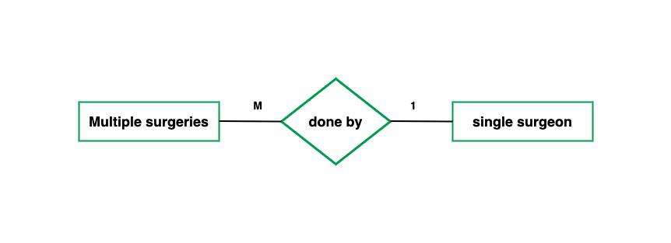

Slide 18
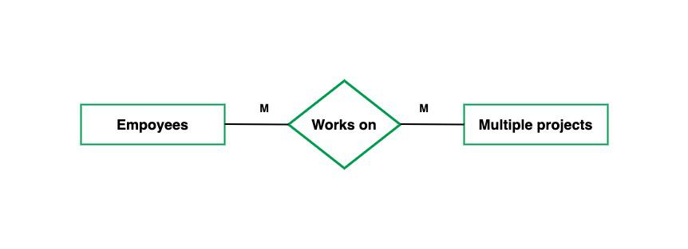
4. Many-to-Many
When entities in all entity sets can take part more than once in the relationship cardinality is many to many. Let us assume that a student can take more than one course and one course can be taken by many students. So the relationship will be many to many.

Slide 19
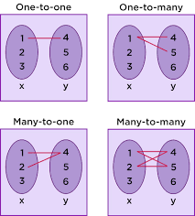

Slide 20
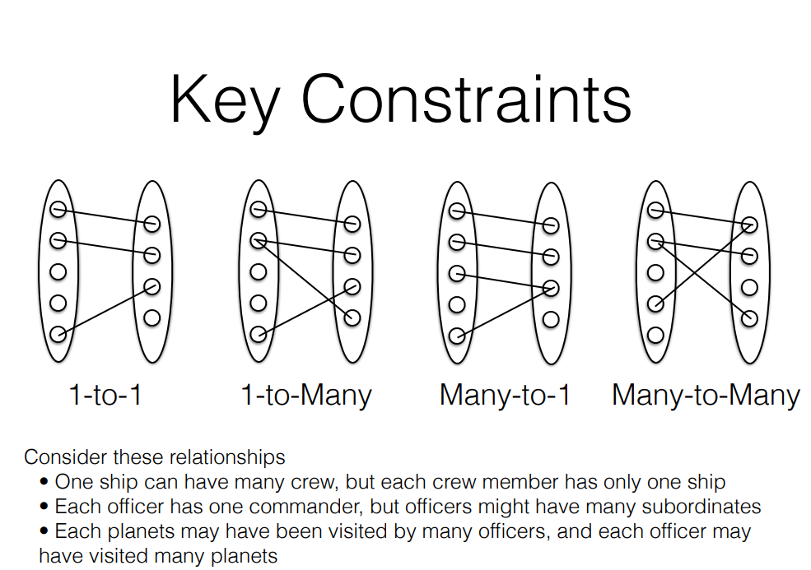

Slide 21
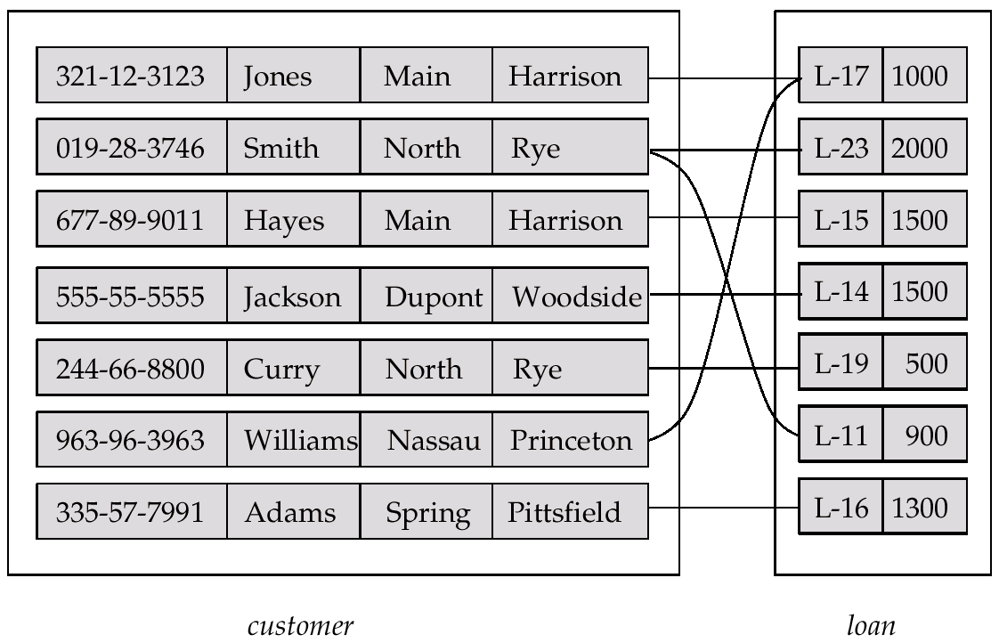
Relationship Set borrower

Slide 22
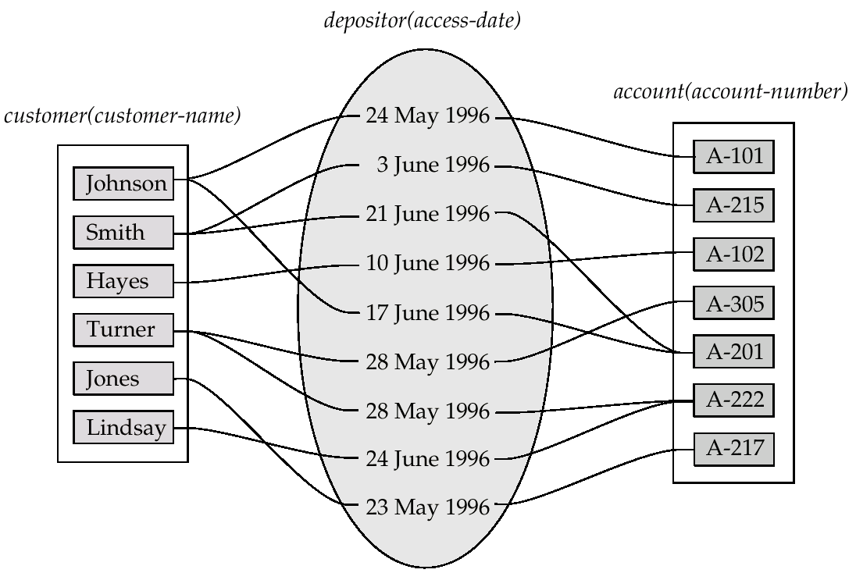
Relationship Sets (Cont.)
An attribute can also be property of a relationship set.
For instance, the depositor relationship set between entity sets customer and account may have the attribute access-date

Slide 23
Summary of Symbols (Cont.)
Notes:
1. Many to Many Relationship
Symbol: A diamond shape labeled "R" with lines connecting to two entity sets, each with multiple arrowheads.
Meaning: Indicates that entities in one set can be related to multiple entities in another set, and vice versa. For example, students can enroll in multiple courses, and each course can have multiple students.
Context: This is a Many-to-Many (M:N) cardinality relationship.
2. Many to One Relationship
Symbol: A diamond shape labeled "R" with a line connecting to one entity set (with multiple arrowheads) and another with a single arrowhead (→).
Meaning: Multiple entities in one set can be related to a single entity in another set. For example, many students can enroll in one course, but each student is linked to only one course at a time.
Context: This is a Many-to-One (M:1) cardinality relationship.
3. One to One Relationship
Symbol: A diamond shape labeled "R" with lines connecting to two entity sets, each with a single arrowhead (↔).
Meaning: Each entity in one set is related to at most one entity in another set, and vice versa. For example, a person can have one passport, and a passport belongs to one person.
Context: This is a One-to-One (1:1) cardinality relationship.
4. One to One Relationship
Symbol: A diamond shape labeled "R" with lines connecting to two entity sets, each with a single arrowhead (↔).
Meaning: Each entity in one set is related to at most one entity in another set, and vice versa. For example, a person can have one passport, and a passport belongs to one person.
Context: This is a One-to-One (1:1) cardinality relationship.
5. Role Indicator
Symbol: A diamond shape labeled "R" connected to an entity "E" with an attribute labeled "role-name".
Meaning: Indicates a role that an entity plays in a relationship. For example, in a "Supervision" relationship, an employee might have roles like "supervisor" or "subordinate".
Context: Useful in recursive relationships (e.g., "SUPERVISION" from your document) where the same entity set participates in multiple roles.
6. ISA (Specialization or Generalization)
Symbol: A triangle labeled "ISA" pointing downward to a set of entities, representing a hierarchy.
Meaning: Shows a generalization (bottom-up) or specialization (top-down) relationship between entity sets. For example, "Person" can be generalized into "Student" and "Teacher", or specialized from a general "Employee" into specific types.
Context: Covered in your document under "Generalization" and "Specialization".
7. Total Generalization
Symbol: An "ISA" triangle with a double line (||) at the base.
Meaning: Indicates that every entity in the higher-level set must belong to at least one of the lower-level subsets (total participation). For example, every "Employee" must be either a "Manager" or a "Staff" member.
Context: Relates to "Total participation" in your document, shown with double lines.
8. Disjoint Generalization
Symbol: An "ISA" triangle with a "disjoint" label at the base.
Meaning: Indicates that an entity in the higher-level set can belong to only one of the lower-level subsets, not multiple. For example, an "Employee" cannot be both a "Manager" and a "Staff" member simultaneously.
Context: A constraint on specialization/generalization to ensure mutual exclusivity.

Slide 24
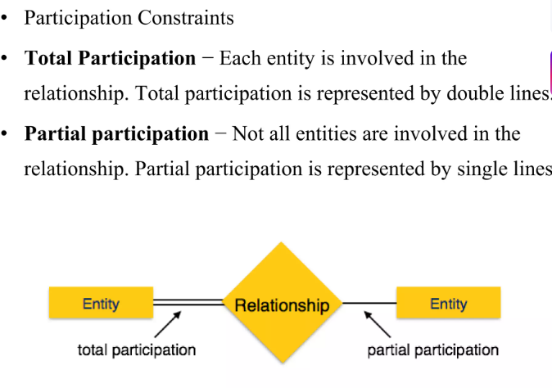

Slide 25
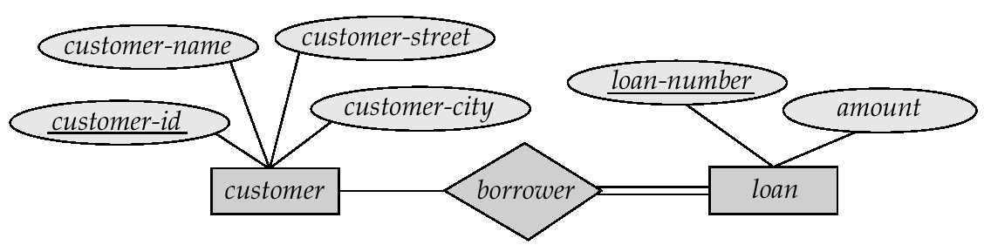
Participation of an Entity Set in a Relationship Set
Total participation (indicated by double line): every entity in the entity set participates in at least one relationship in the relationship set
E.g. participation of loan in borrower is total
every loan must have a customer associated to it via borrower
Partial participation: some entities may not participate in any relationship in the relationship set
E.g. participation of customer in borrower is partial
Notes:
Total Participation
Definition: In an Entity-Relationship (E-R) model, total participation means that every entity in an entity set must participate in at least one instance of the relationship set. In other words, no entity in that set can exist without being involved in the relationship.
Representation: Indicated by a double line connecting the entity set to the relationship diamond in an E-R diagram.
Example from Slides: The participation of the "loan" entity in the "borrower" relationship is total. This means every loan must have at least one customer associated with it via the borrower relationship (i.e., a loan cannot exist without a borrower).
Partial Participation
Definition: Partial participation means that some entities in an entity set may not participate in any instance of the relationship set. Only certain entities are involved, while others can exist independently without the relationship.
Representation: Indicated by a single line connecting the entity set to the relationship diamond in an E-R diagram.
Example from Slides: The participation of the "customer" entity in the "borrower" relationship is partial. This means not every customer needs to have a loan; some customers might exist in the system without borrowing anything.

Slide 26
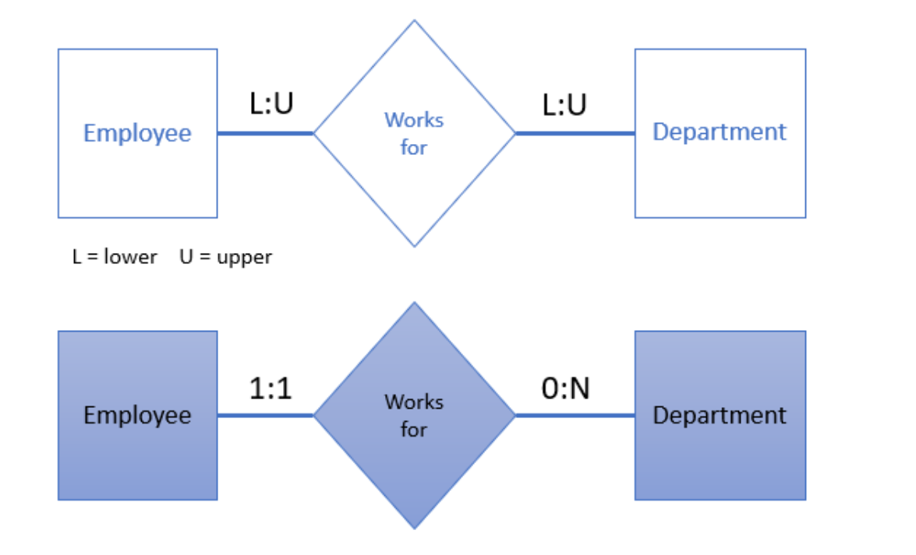
Cardinality Constraint (min,max)

Slide 27
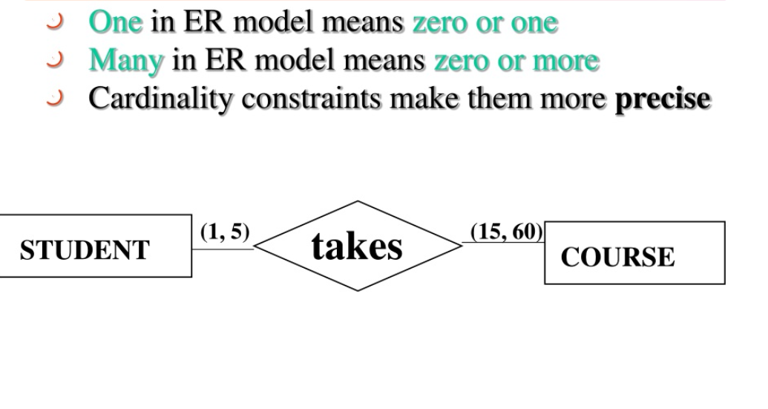
Cardinality Constraint (min,max)

Slide 28
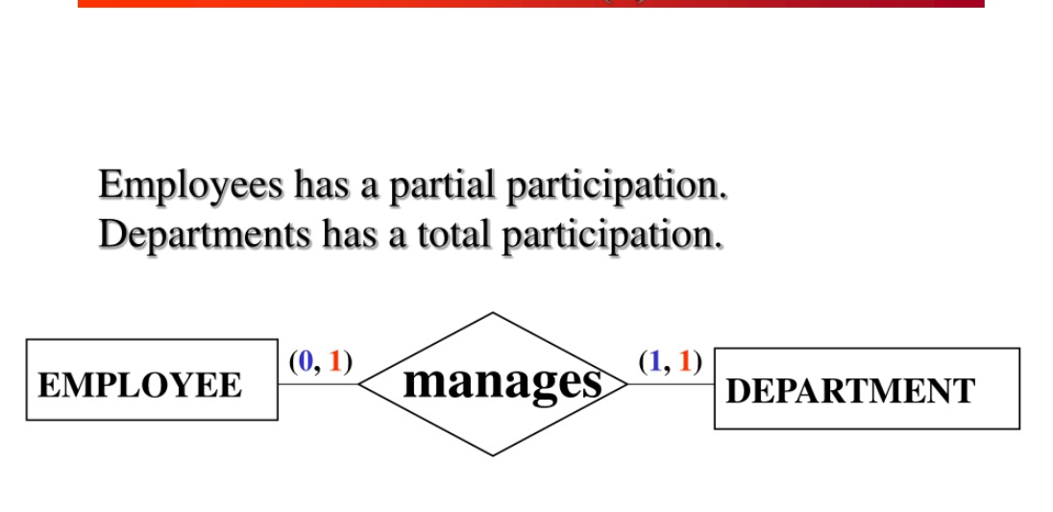
Cardinality Constraint (min,max)

Slide 29
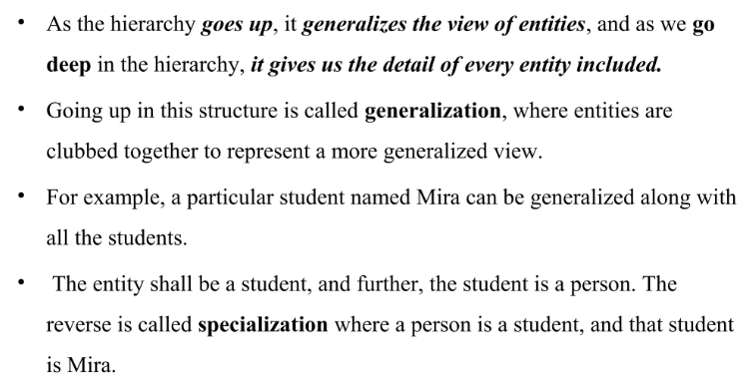
Generalization
Notes:
Generalization in E-R Diagrams
Definition: Generalization is a bottom-up process where multiple lower-level entity sets (subsets) are combined into a single higher-level entity set (superclass) based on common characteristics.
Explanation: It abstracts common attributes and relationships from specific entity types to create a more general entity. This is useful when you identify that several specific entities share similar properties.
Example: In a university database, "Student," "Teacher," and "Staff" might be combined into a general "Person" entity, as they all share attributes like "name" and "ID."
Representation: An "ISA" triangle points upward from the lower-level entities (e.g., Student, Teacher) to the higher-level entity (e.g., Person).

Slide 30
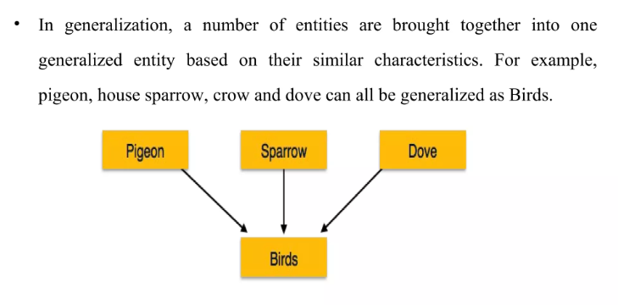
Generalization

Slide 31
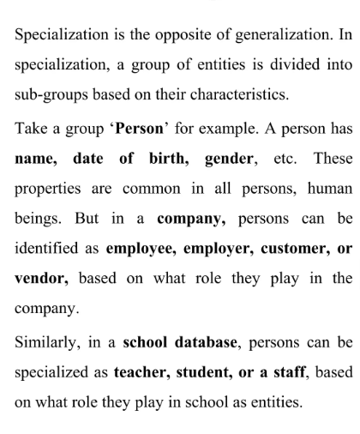
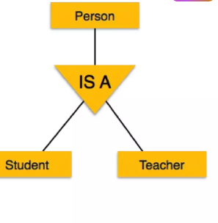
Specialization
Notes:
Specialization in E-R Diagrams
Definition: Specialization is a top-down process where a higher-level entity set (superclass) is divided into multiple lower-level entity sets (subsets) based on specific distinguishing characteristics.
Explanation: It refines a general entity into more specific types by adding unique attributes or relationships. This is useful when a general entity needs to be categorized into more detailed types.
Example: Starting with a "Person" entity, it can be specialized into "Student" (with attributes like "enrollment_date") and "Teacher" (with attributes like "salary").

Slide 32
How to Draw an ER Diagram
1. Identify Entities: The very first step is to identify all the Entities. Represent these entities in a Rectangle and label them accordingly.
2. Identify Relationships: The next step is to identify the relationship between them and represent them accordingly using the Diamond shape. Ensure that relationships are not directly connected to each other.
3. Add Attributes: Attach attributes to the entities by using ovals. Each entity can have multiple attributes (such as name, age, etc.), which are connected to the respective entity.
4. Define Primary Keys: Assign primary keys to each entity. These are unique identifiers that help distinguish each instance of the entity. Represent them with underlined attributes.
5. Remove Redundancies: Review the diagram and eliminate unnecessary or repetitive entities and relationships.
6. Review for Clarity: Review the diagram make sure it is clear and effectively conveys the relationships between the entities.

Slide 33
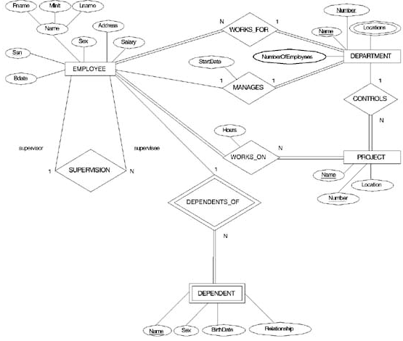
Recursive Relationship Type is: SUPERVISION (participation role names are shown)

Slide 35
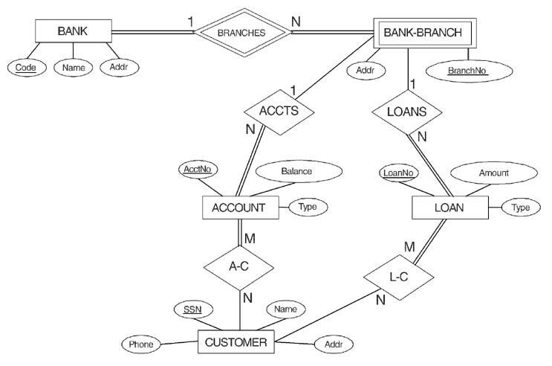
ER DIAGRAM FOR A BANK DATABASE
© The Benjamin/Cummings Publishing Company, Inc. 1994, Elmasri/Navathe, Fundamentals of Database Systems, Second Edition

Slide 36
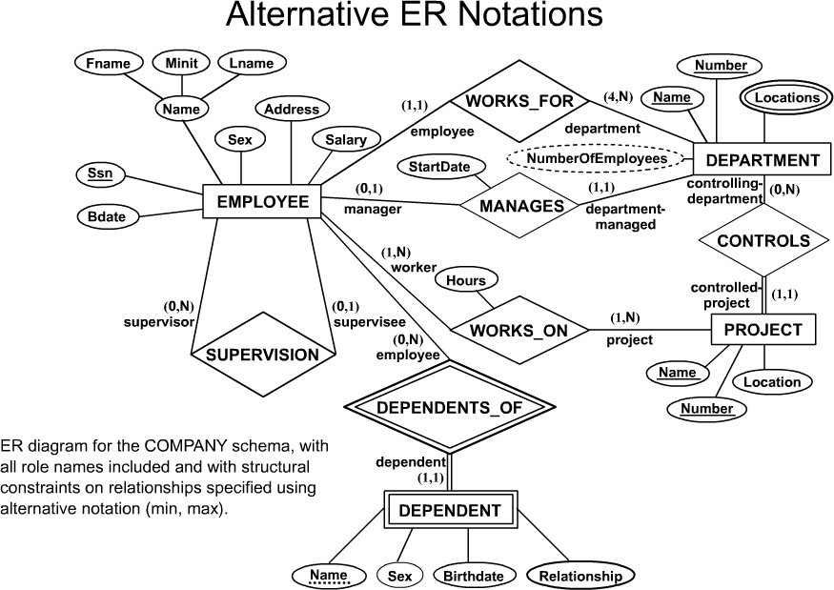

Slide 37
The National Hockey League (NHL) comprises numerous teams.
Each team is characterized by a name, city, coach, captain, and roster of players.
Every player is affiliated with a single team exclusively.
Player details include name, position (e.g., left wing, goalie), skill level, and injury history.
The team captain concurrently holds the status of a player.
Matches are contested between two teams, designated as host_team and guest_team.
Each match is recorded with a specific date (e.g., May 11, 1999) and final score (e.g., 4 to 2).

Slide 38
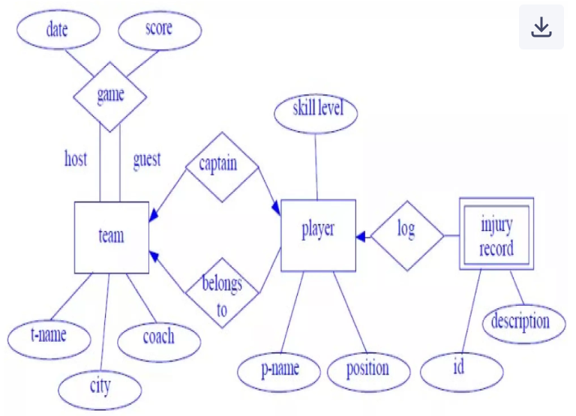

Slide 39
Question 3:
Construct an Entity-Relationship (E-R) diagram for a car insurance company in which each customer possesses one or more automobiles. Each automobile may be associated with zero or multiple recorded accidents.
(b) Formulate appropriate relational tables corresponding to the aforementioned E-R diagram.

Slide 40
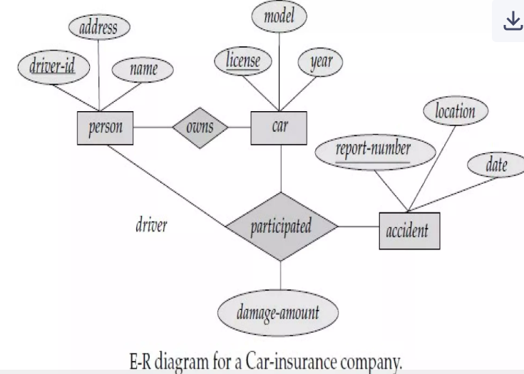

Slide 41
Question 2: A university registrar tracks:
Courses: number, title, credits, syllabus, prerequisites
Offerings: course number, year, semester, section, instructor(s), time, classroom
Students: ID, name, program
Instructors: ID, name, department, title Also, model student enrollments and grades. Create an E-R diagram and note any assumptions about relationships.

Slide 42
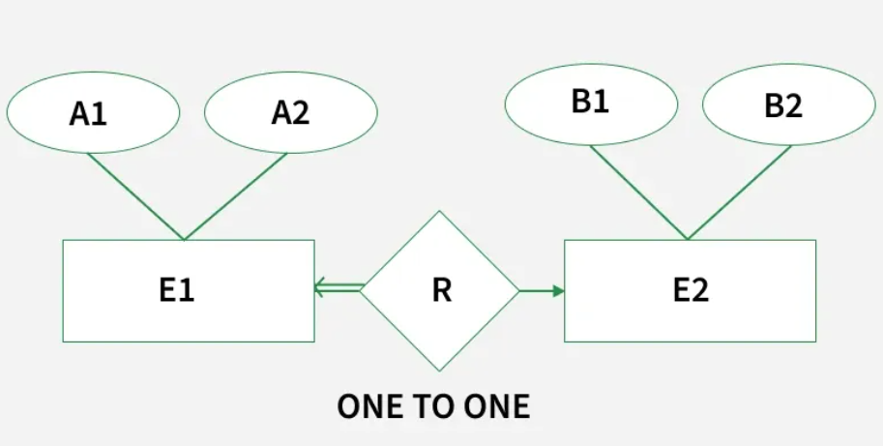

Slide 43
Minimization of ER Diagrams
Minimization of ER Diagram simply means reducing the number of the tables in the ER Diagram. When there are so many tables present in the ER Diagram, it decreases its readability and understandability and it also becomes difficult for the admin also to understand these. Minimizing the ER Diagram helps in better understanding. We reduce tables depending on the cardinality.

